Slide 1
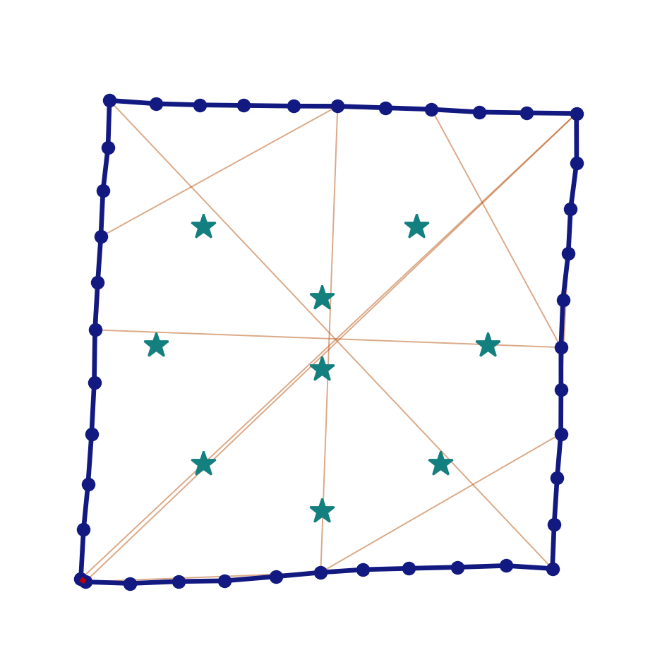
L9.1 SLAM Fundamentals
Zonghua Gu | Fall 2026

Slide 2
Roadmap and Learning Outcomes
Part 1
Part 2
Part 3
Part 4
The SLAM Problem
Why localize, drift, problem definition, models, map types
Lecture A | ~30 min
Filtering SLAM
Bayes filter, EKF-SLAM, worked example, data association
Lecture A | ~35 min
Particle and Graph SLAM
FastSLAM, pose graphs, Gauss-Newton, sparsity
Lecture B | ~40 min
Loop Closure
False loops, robust back-ends, ATE and RPE, lab
Lecture B | ~25 min
After this lecture you should be able to:
1. Explain why localization and mapping must be solved jointly, and what online and full SLAM estimate
2. Run one EKF-SLAM update by hand and explain why landmark estimates become correlated
3. Formulate a pose graph, build H and b for a small example, and solve it with Gauss-Newton
4. Compare EKF, particle, and graph back-ends, and evaluate a SLAM result with ATE

Slide 3
Where Localization and Mapping Fit
Sensors
Perception
Localization
and Map
Prediction
Planning
Control
camera, LiDAR,
radar, GNSS/IMU,
wheel odometry
detect, segment,
track objects
where am I?
what is around me?
future motion
of agents
route, behavior,
trajectory
steer, throttle,
brake
Localization gives every other module the vehicle pose in the map frame; planning and control depend on it
Mapping produces the maps that localization, prediction, and planning rely on: landmark, grid, point-cloud, and HD vector maps
Today: how a vehicle can build a map while localizing in it, with no prior map
Next lecture (L9.2): modern visual and LiDAR SLAM, map-based localization in AD stacks, and how they can be attacked
Stack layout as in L1.1 and L6. Localization and map are shown as one block because they are usually estimated together.

Slide 4
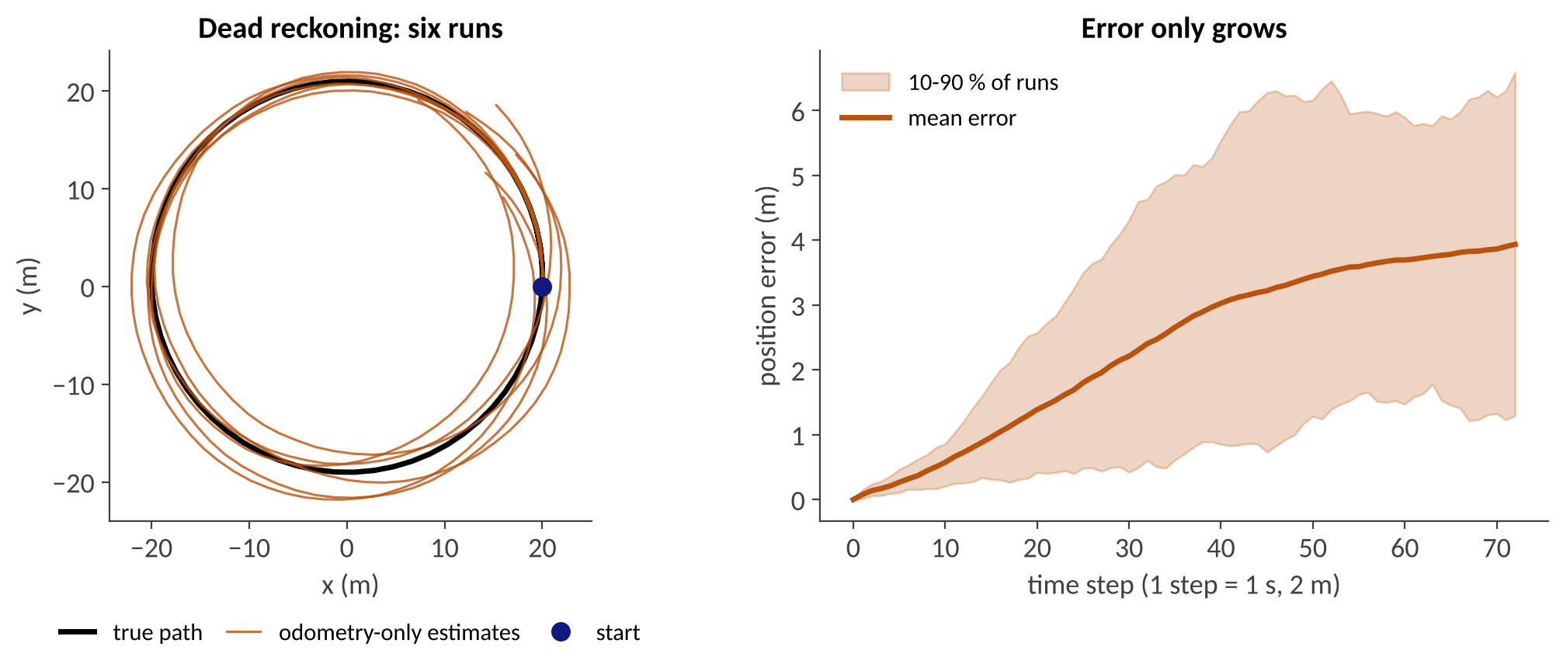
Part 1: The SLAM Problem
Why localize | dead reckoning | definitions | models | maps

Slide 5
Why Not Just Use GNSS?
Standard GNSS errors are several meters; RTK can reach centimeters but needs correction data and a clear view of the sky
Tunnels, parking garages, and urban canyons block or reflect the signals (multipath)
Lane-level driving needs a decimeter-level lateral error and a pose expressed in the map frame
Fusing GNSS with IMU and wheel odometry helps, but dead reckoning still drifts when GNSS drops out
Idea: use what the vehicle sees (landmarks, scans) to correct its own motion estimate, and build the map at the same time
See also L1.2 (sensors, GNSS/RTK) and Cadena et al., "Past, Present, and Future of SLAM", T-RO 2016.

Slide 6
Localization, Mapping, and SLAM
Localization
Mapping
SLAM
Given: map m and measurements
Estimate: pose x
Given: poses x and measurements
Estimate: map m
Given: only controls u and measurements z
Estimate: pose x and map m
e.g., match a LiDAR scan to a prior point-cloud map
e.g., register scans from known poses
a chicken-and-egg problem
A good map needs good poses, and a good pose needs a good map
SLAM solves both jointly: every new observation refines the map and the pose
Typical use cases: first drive in a new area, building HD maps, GPS-denied driving, robots and drones

Slide 7
Dead Reckoning Drifts
Odometry integrates noisy velocity and yaw-rate readings; errors accumulate and never shrink
In our simulation (circle of radius 20 m, ~1.1 laps, noise 0.1 m/s and 0.02 rad/s) the mean error reaches 3.9 m
Heading error is the worst: a small angle error becomes a large position error with distance
Without an external reference the error is unbounded
Original figure: simulated unicycle model, 60 runs. Noise values are illustrative, not from a specific vehicle.

Slide 8
The SLAM Loop
1 Move
2 Sense
3 Associate
4 Update
predict the pose from odometry
(uncertainty grows)
observe landmarks or a scan
match observations to map entries
correct pose and map;
add new landmarks
repeat at every time step
Re-observing the same landmark from different poses links those poses through the map
Pose uncertainty and map uncertainty are coupled: improving one improves the other
This loop is the same for EKF-SLAM, FastSLAM, and graph SLAM; only the way the posterior is stored and updated differs

Slide 9
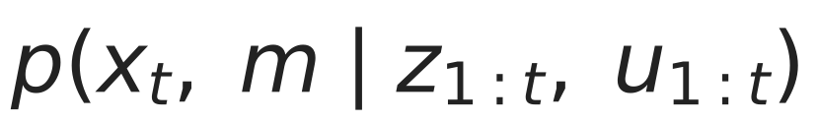
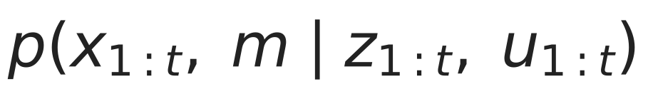
Online vs. Full SLAM
Given the controls u and the measurements z up to time t, estimate the map m and the vehicle pose(s) x
Online SLAM
(filtering)
only the current pose; past poses are integrated out
(EKF-SLAM, FastSLAM)
Full SLAM
(smoothing)
the whole trajectory
(graph SLAM, bundle adjustment)
x = poses, m = map, u = controls (odometry), z = measurements; unknown data association c says which landmark each z belongs to
Online SLAM is the full posterior with past poses integrated out; full SLAM keeps them and can revise them later
Notation follows Thrun, Burgard, and Fox, Probabilistic Robotics, Ch. 10.

Slide 10
SLAM as a Graphical Model
u₁
u₂
u₃
shaded = observed
(controls, measurements)
x₀
x₁
x₂
x₃
z₁
z₂
z₃
m
m is shared by all measurements: this is what couples the poses together
Markov assumption: the pose at time t depends only on the previous pose and the latest control

Slide 11
Motion and Measurement Models
Motion model from odometry u = (v, ω), with Gaussian noise of covariance R:
Measurement model: range-bearing to landmark (m_x, m_y), with noise covariance Q:
Both models are nonlinear, so the Kalman filter must be linearized (EKF) or replaced by particles or least squares
Other sensors give other h(·): camera pixel (u, v), LiDAR scan-to-map overlap, GNSS position
Noise covariances R and Q come from datasheets or calibration; wrong values make the filter over- or under-confident
Heading noise in R is the dominant source of drift (see the simulation on slide 7)

Slide 12
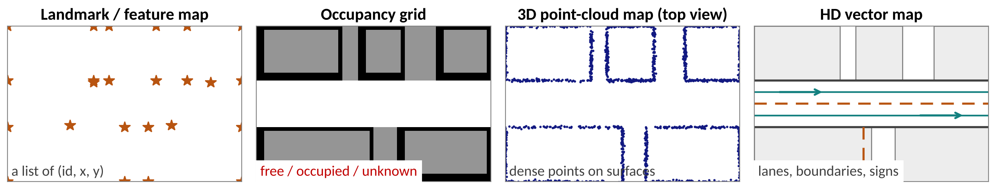
What Is a Map?
Landmark map: sparse list of (id, x, y); used by EKF-SLAM and FastSLAM; needs a feature extractor
Occupancy grid: free / occupied / unknown per cell; used by planners; memory grows with the area
Point-cloud map: dense 3D points; used for scan-matching localization (ICP, NDT, see L6)
HD vector map: lanes, boundaries, signs; built offline with SLAM plus annotation (see L1.2)
Original synthetic scene (top view).

Slide 13
Three Families of SLAM Back-Ends
 | Kalman filter (EKF-SLAM) | Particle filter (FastSLAM) | Graph optimization (pose / factor graph)
Posterior | one Gaussian over pose and map | samples of the path; one small Gaussian per landmark | whole trajectory (full SLAM)
Update | online, recursive | online, recursive | batch or incremental least squares
Strength | simple; uncertainty explicit | handles non-Gaussian pose; per-particle data association | accurate; sparse; can revise the past
Weakness | O(N²) cost; linearization errors | needs many particles; path depletion | needs a good initial guess and loop detection
Today | teaching, small maps, sensor fusion | grid mapping (GMapping) | most modern visual and LiDAR SLAM

Slide 14
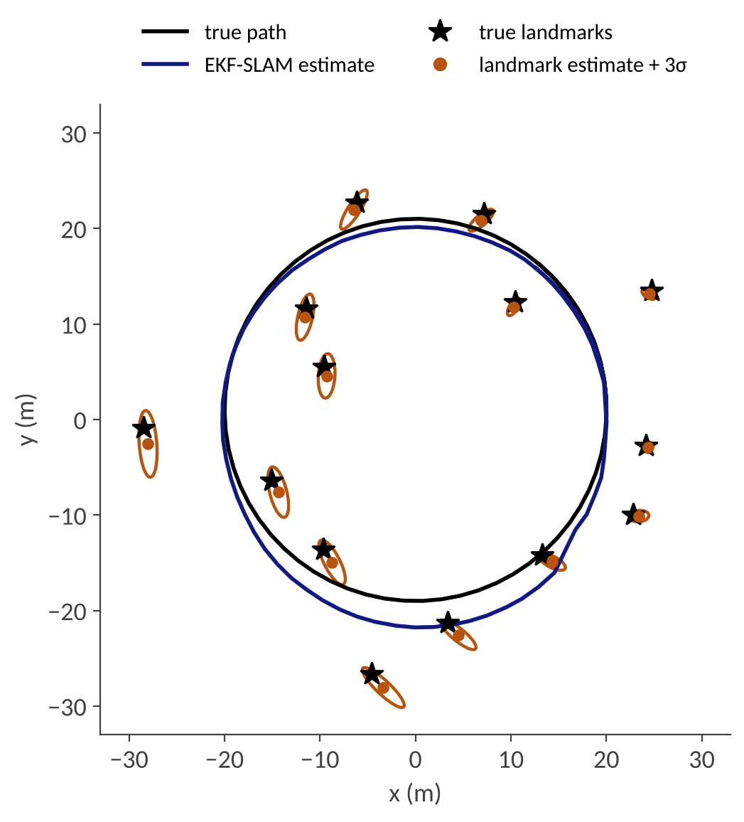
Part 2: Filtering SLAM (EKF)
Bayes filter | EKF-SLAM | worked example | data association

Slide 15
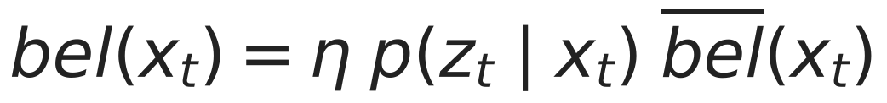
Bayes Filter Recap
Keep a belief over the state; update it recursively with two steps
Predict: push the belief through the motion model (uncertainty grows)
Correct: multiply by the measurement likelihood and normalize (uncertainty shrinks)
For linear-Gaussian models this is the Kalman filter; with Jacobians of g and h it becomes the EKF, the same filter used for object tracking in L6. In SLAM the state simply contains the map as well.

Slide 16
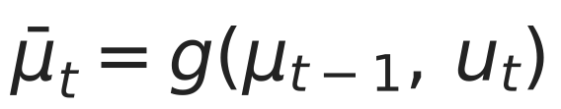
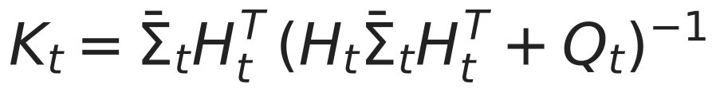
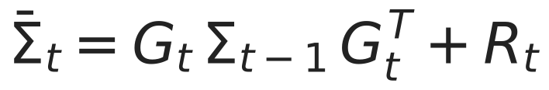
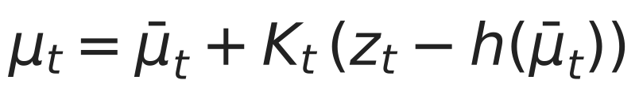
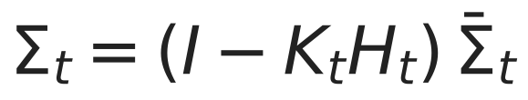
EKF Recap
State μ, covariance Σ. Motion g with Jacobian G; measurement h with Jacobian H; noise covariances R, Q.
Predict
Correct
The innovation ν = z − h(predicted mean) tells how surprising the measurement is; its covariance is S = H Σ H^T + Q (Σ = predicted covariance)
K balances trust: large Q (noisy sensor) → small K; large predicted Σ (uncertain state) → large K

Slide 17
EKF-SLAM: State and Covariance
Stack the robot pose and all landmark positions in one Gaussian:
Σ_rr
3×3
Σ_rm (3×2N)
Σ_mr
Σ_mm (2N×2N)
landmark covariances
and cross-covariances
dimension 3 + 2N; Σ is a (3+2N) × (3+2N) matrix
Σ_rr: uncertainty of the robot pose
Σ_mm diagonal blocks: uncertainty of each landmark
Off-diagonal blocks: correlations between pose and landmarks, and between landmarks
In our simulation with N = 14 landmarks: 31 × 31
Σ = [ Σ_rr Σ_rm ; Σ_mr Σ_mm ]

Slide 18
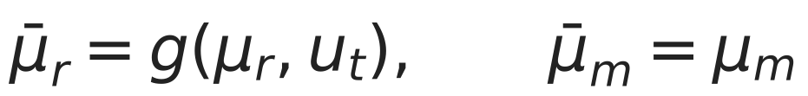
EKF-SLAM: Predict Step
Only the robot moves; landmarks are static. The motion Jacobian has a simple structure:
G is 3×3 and acts only on the robot block; the landmark block of the full Jacobian is the identity
Cost is O(N): only the robot rows and columns of Σ change
Σ_rr grows by R every step, so the pose uncertainty rises when nothing is observed
Cross-covariances Σ_rm are rotated by G: the map stays correlated with the (moved) robot

Slide 19
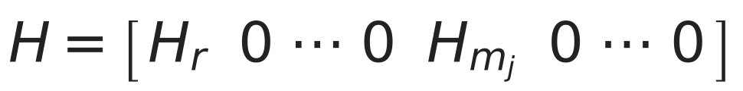
EKF-SLAM: Update Step
For each observed landmark j with measurement z = (r, φ):
H is sparse: nonzero only in the robot columns and in the columns of landmark j
But the gain K = Σ H^T S^-1 is a full (3+2N)×2 matrix: every landmark and the robot are corrected, even landmarks not observed now
Σ ← (I − K H) Σ touches the entire matrix: cost O(N²) per observation
Angles must be wrapped to (−π, π] when forming ν

Slide 20
Adding a New Landmark
First sighting of a landmark: initialize it from the pose and the measurement (inverse observation model).
Append two rows and columns to μ and Σ; new covariance block = J_x Σ_rr J_x^T + J_z Q J_z^T
The new landmark is correlated with the robot from the start (through J_x Σ_r,·), so it inherits the pose uncertainty
Its covariance is therefore large when the robot pose is uncertain, even if the sensor is precise
Practical systems add a landmark only after it is seen several times, to avoid initializing outliers

Slide 21
Worked Example: 1-D EKF-SLAM
Robot on a line, state (x, m). Start x = 0 (known), first range gives m = 5.1 with variance 0.04. Then move u = +1 (Q = 0.04) and measure z = m − x = 3.9 (R = 0.04).
Step | Mean (x, m) | Covariance Σ
0 initialize landmark | (0, 5.1) | [[0, 0], [0, 0.04]]
1 predict (move +1) | (1, 5.1) | [[0.04, 0], [0, 0.04]]
2 innovation ν = 3.9 − (5.1 − 1) = −0.2 | S = 0.04 + 0.04 + 0.04 = 0.12 | K = (−0.333, +0.333)
3 update | (1.067, 5.033) | [[0.0267, 0.0133], [0.0133, 0.0267]]
The robot moved +1.067 (not +1): the measurement says the landmark is closer, and the filter splits the blame between x and m
Both variances dropped from 0.04 to 0.0267, and a correlation ρ = 0.0133 / 0.0267 = 0.5 appeared between x and m
Hand-checkable numbers; reproduced in the exercise deck and verified in Python.

Slide 22
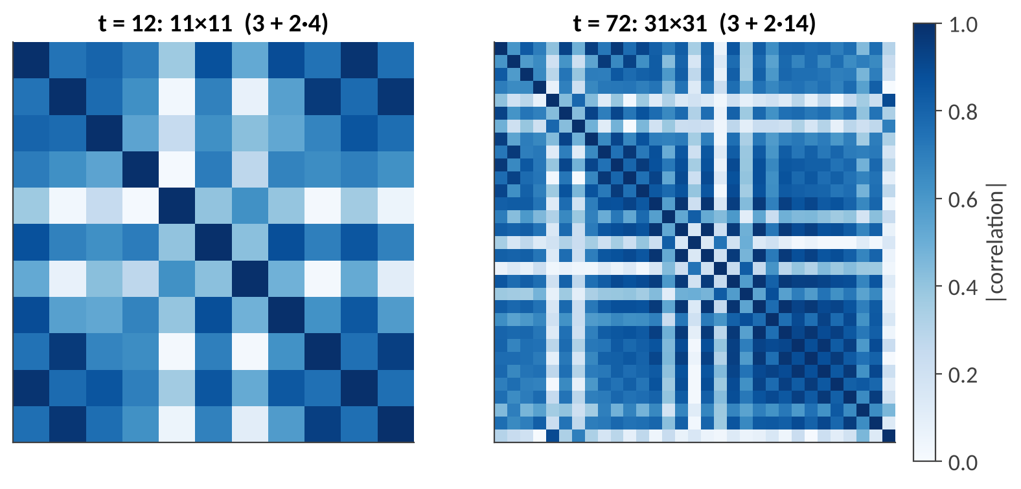
Correlations Are the Key
Every observation links the robot and a landmark; over time all landmarks become correlated through the robot pose
Correlations make the filter consistent: a correction for one landmark propagates to the others
They also make Σ dense: O(N²) memory and update time
Ignoring correlations (independent per-landmark filters) is overconfident and inconsistent
Left: after 12 steps (4 landmarks). Right: after 72 steps (14 landmarks). Dark = strong correlation.
Original figure from our EKF-SLAM simulation (range-bearing, known data association).

Slide 23
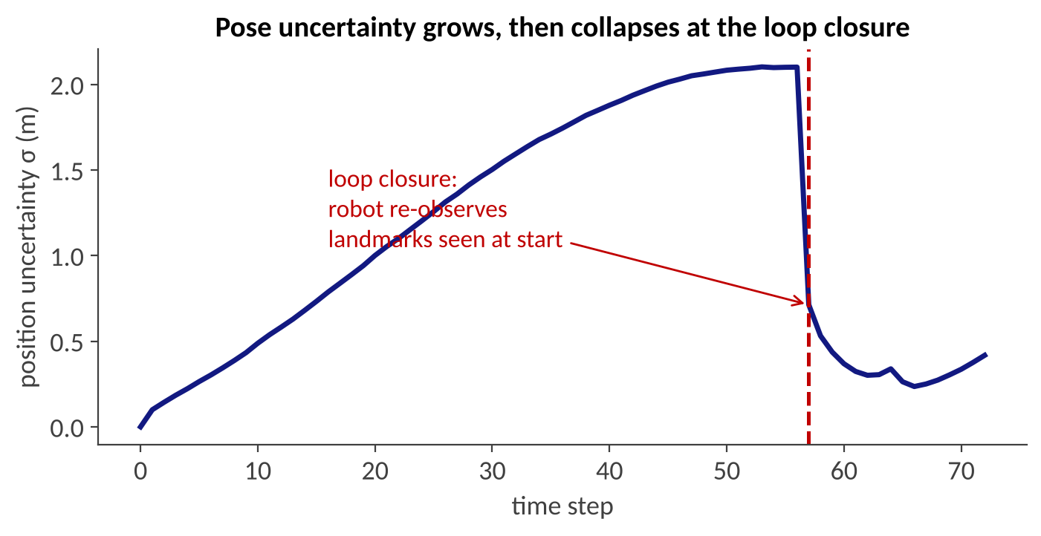
EKF-SLAM in Action
Pose σ grows to 2.1 m while exploring, then drops to 0.4 m at the loop closure (t = 57)
The estimate "snaps back": loop closure corrects past drift in the map as well
Original simulation: 14 landmarks, range 12 m, σ_r = 0.3 m, σ_φ = 1°, 72 steps; known data association.

Slide 24
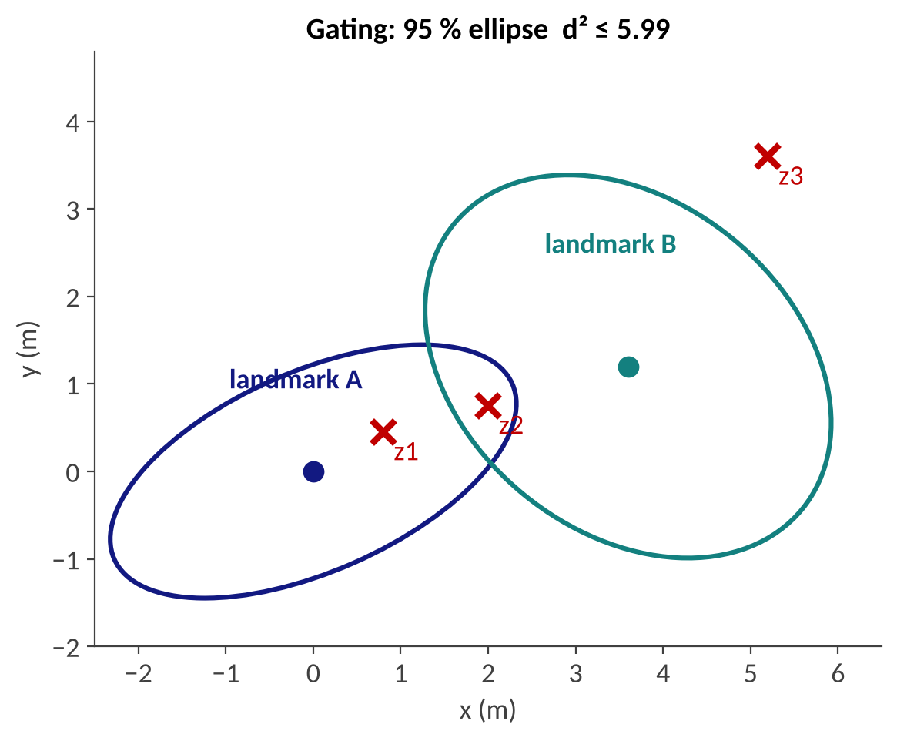
Data Association and Gating
Which landmark did this measurement come from? Unknown in practice
Gate by Mahalanobis distance d² = ν^TS^-1ν; for 2 DOF a 95 % gate is d² ≤ 5.99
z1 → A only (d² = 0.85); z2 is inside both gates (4.47 and 3.94): ambiguous; z3 is outside all gates → new landmark or outlier
Nearest neighbor is cheap; JCBB or multi-hypothesis methods handle ambiguity
A wrong match is catastrophic for EKF-SLAM: it commits to one hypothesis and cannot undo it
Original illustration; χ²₂(0.95) = 5.99, χ²₂(0.99) = 9.21.

Slide 25
Limits of EKF-SLAM
Complexity: O(N²) update and memory; thousands of landmarks are impractical
Linearization: errors in the Jacobians make the filter overconfident (inconsistent), especially after large heading errors
Gaussian assumption: cannot represent multi-modal pose belief, e.g., symmetric corridors
Single data-association hypothesis per update (see previous slide)
Past poses are marginalized out: cannot be re-linearized once a loop closure reveals a better estimate
Still the best way to learn SLAM, and the core of many sensor-fusion filters
Durrant-Whyte and Bailey, "Simultaneous Localization and Mapping: Part I", IEEE RAM 2006; Thrun et al., Probabilistic Robotics, Ch. 10.

Slide 26
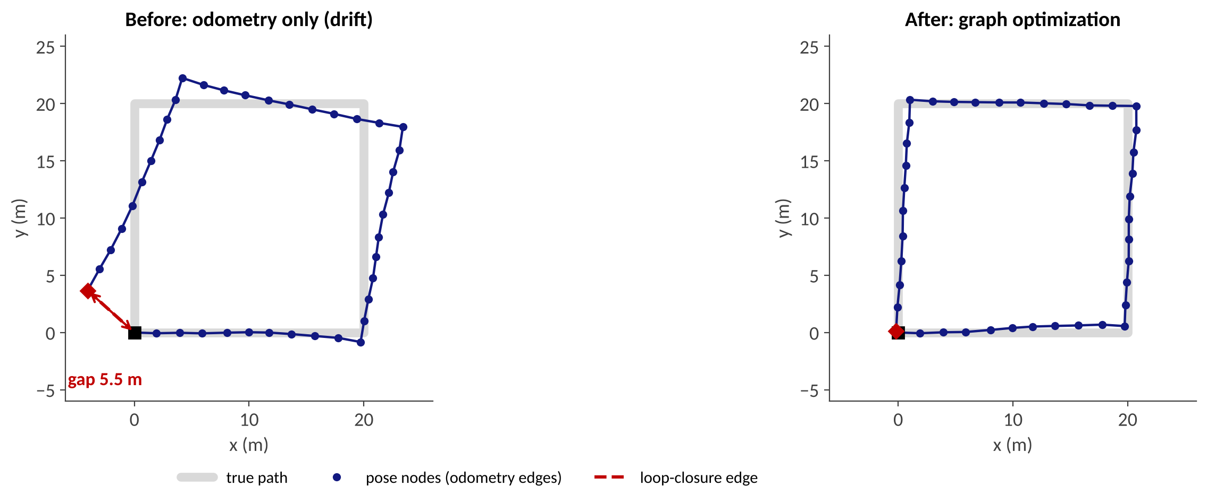
Part 3: Particle and Graph SLAM
FastSLAM | pose graphs | Gauss-Newton | sparsity

Slide 27
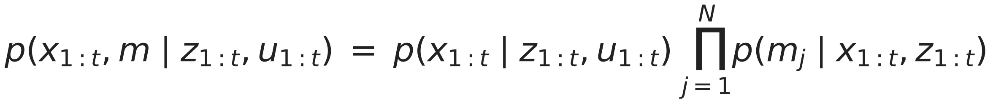
FastSLAM: Key Idea
Observation: if the robot path were known, the landmarks would be independent
So factor the posterior into a path term and one small term per landmark (Rao-Blackwellization):
↑ path: particle filter
↑ one 2×2 EKF per landmark
Each particle = one path hypothesis + N tiny 2×2 EKFs (one per landmark), instead of one huge (3+2N) Gaussian
Cost per observation is O(log N) per particle with a tree of landmarks: O(M log N) for M particles, versus O(N²) for EKF-SLAM
Data association is decided per particle, so different particles can hold different hypotheses
Montemerlo, Thrun, Koller, Wegbreit, "FastSLAM", AAAI 2002.

Slide 28
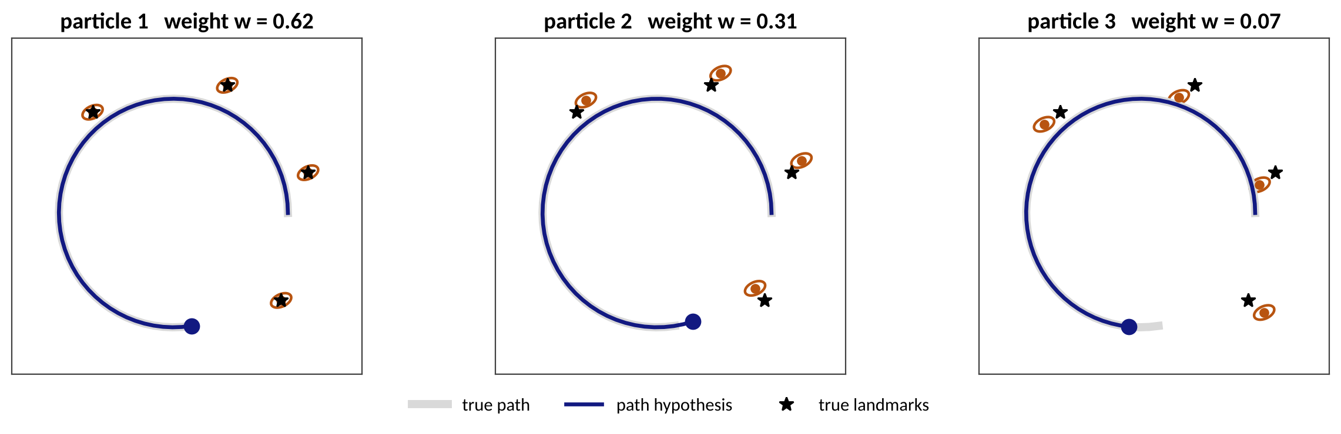
FastSLAM: Algorithm and Behavior
Sample pose
Update landmarks
Weight
Resample
draw the new pose from the motion model for each particle
EKF update of the observed 2×2 landmark filters
importance weight = measurement likelihood
copy particles ∝ weight; reset weights
Our simulation: M = 40 particles; after the loop closure the effective sample size fell to 6.8
Particle depletion: resampling keeps only a few ancestors, so good hypotheses can be lost
FastSLAM 2.0 samples the pose using the measurement as well
Left: schematic of three particles (weights illustrative). Numbers: original FastSLAM 1.0 simulation, known association.

Slide 29
From Landmarks to Grids: GMapping
Same idea with a 2D LiDAR and an occupancy grid: every particle carries its own grid map
Scan matching against the particle's map improves the proposal, so few particles are needed (tens)
Widely used in ROS for indoor robots; memory grows with particles × map size
Weak in large outdoor loops and in 3D: the reason graph-based methods took over
Grisetti, Stachniss, Burgard, "Improved Techniques for Grid Mapping with Rao-Blackwellized Particle Filters", T-RO 2007.

Slide 30
Graph SLAM: Nodes and Edges
loop-closure edge (x_0, x_4)
x1
x3
x5
x0
x2
x4
odometry edge (x_i, x_{i+1})
Node = a pose x_i (or a landmark); edge = a relative measurement z_ij between two nodes, with an information matrix Ω (the inverse of its covariance)
Odometry edges connect consecutive poses; loop-closure edges connect distant poses that saw the same place
No filtering: build the whole graph, then find the poses that best satisfy all constraints
Grisetti, Kümmerle, Stachniss, Burgard, "A Tutorial on Graph-Based SLAM", IEEE ITS Magazine 2010.

Slide 31
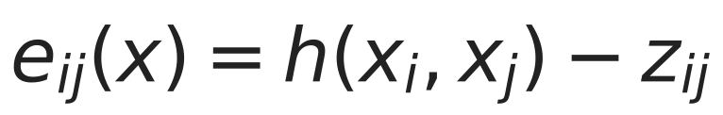
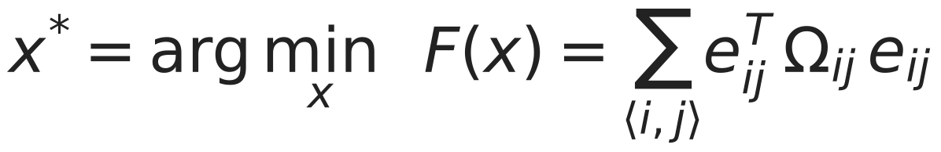
The Graph SLAM Objective
Each edge predicts the relative pose from the current node estimates and compares it with the measurement z_ij:
h(x_i, x_j) = pose of node j seen from node i (in SE(2): a rotation and a translation); for 1-D it is just x_j − x_i
Ω_ij weights each edge: precise edges (large Ω) pull harder than noisy ones
This is a nonlinear least-squares problem: it is the maximum-likelihood estimate under Gaussian noise
The same formulation is used for visual SLAM (bundle adjustment) and factor graphs

Slide 32
Solving It: Gauss-Newton
Linearize each error around the current estimate: e(x + Δx) ≈ e + J Δx
Set the derivative of F to zero to get the normal equations; solve, update, repeat:
Each edge adds a small contribution to H and b: only the blocks of its two nodes
Iterate until Δx is small (our 41-pose example converges in about 6 iterations)
Levenberg-Marquardt adds a damping term λI for robustness; g2o, GTSAM, and Ceres implement this
Needs a good initial guess (usually odometry): the problem is nonconvex

Slide 33
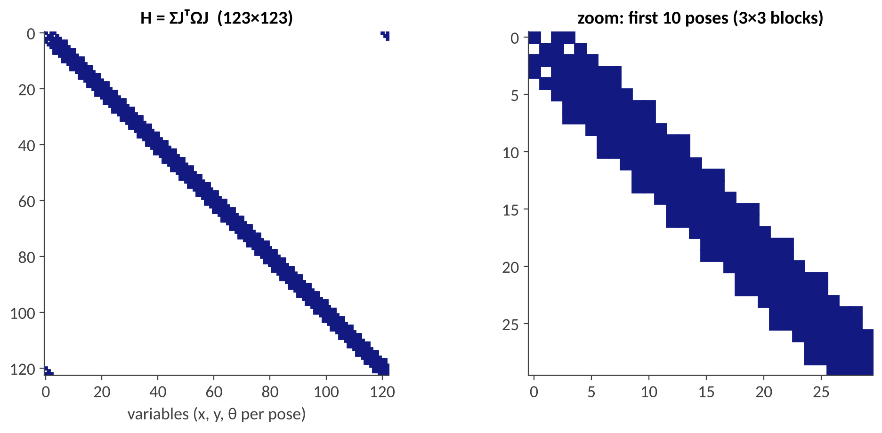
Sparsity Makes It Fast
41 poses × 3 = 123×123 matrix, but only 6 % of entries are nonzero
An edge touches only two nodes, so H mirrors the adjacency of the graph
Odometry edges give the band; the loop-closure edge adds off-band blocks in the corners
Sparse Cholesky solves large graphs (10⁵ nodes and more) in seconds
Gauge freedom: relative constraints cannot fix the absolute pose, so H is singular. Fix one node (prior on x₀) or remove its rows and columns. H^-1 then gives the covariance.

Slide 34
Worked Example: 1-D Pose Graph
Fixed x₀ = 0, unknowns x₁, x₂. Odometry: x₁ − x₀ = 1.0 and x₂ − x₁ = 1.0 (σ = 0.1). "Loop-closure" edge: x₂ − x₀ = 1.8 (σ = 0.05). Start from the odometry guess x = (1, 2).
Edge | Ω = 1/σ² | e at x = (1, 2) | J (w.r.t. x₁, x₂)
x₁ − x₀ = 1.0 | 100 | 0 | (1, 0)
x₂ − x₁ = 1.0 | 100 | 0 | (−1, 1)
x₂ − x₀ = 1.8 | 400 | +0.2 | (0, 1)
H = [[200, −100], [−100, 500]]
b = (0, 80), H Δx = −b → Δx = (−0.089, −0.178)
Result: x = (0.911, 1.822); the 0.2 m disagreement is spread over both edges, more on the less precise odometry
H^-1 gives the posterior covariance: σ(x₁) ≈ 0.075, σ(x₂) ≈ 0.047, tighter than the odometry alone
The problem is linear, so one Gauss-Newton step is exact; checked against a direct solver

Slide 35
Pose Graph Optimization in Action
41 poses on a 20 m × 20 m square; odometry-only gap at the end 5.5 m, after optimization 0.22 m
Trajectory RMSE (ATE): 3.01 m → 0.62 m; one loop-closure edge corrects the whole path
Original simulation: SE(2) pose graph, noise σ = (0.12 m, 0.05 m, 0.035 rad) per step, solved with Levenberg-Marquardt.

Slide 36
Front-End and Back-End
Sensor data
camera, LiDAR,
IMU, wheels
Front-end
odometry, scan / feature matching,
place recognition, data association
Graph
nodes + edges
Back-end
optimization
better poses help the front-end find constraints
Front-end (sensor-specific): turns raw data into constraints; this is where most failures happen (bad matches, false loops)
Back-end (sensor-agnostic): optimizes the graph; robust against some bad edges (next part)
This split is the architecture of nearly every modern SLAM system, including ORB-SLAM, LIO-SAM, and Cartographer

Slide 37
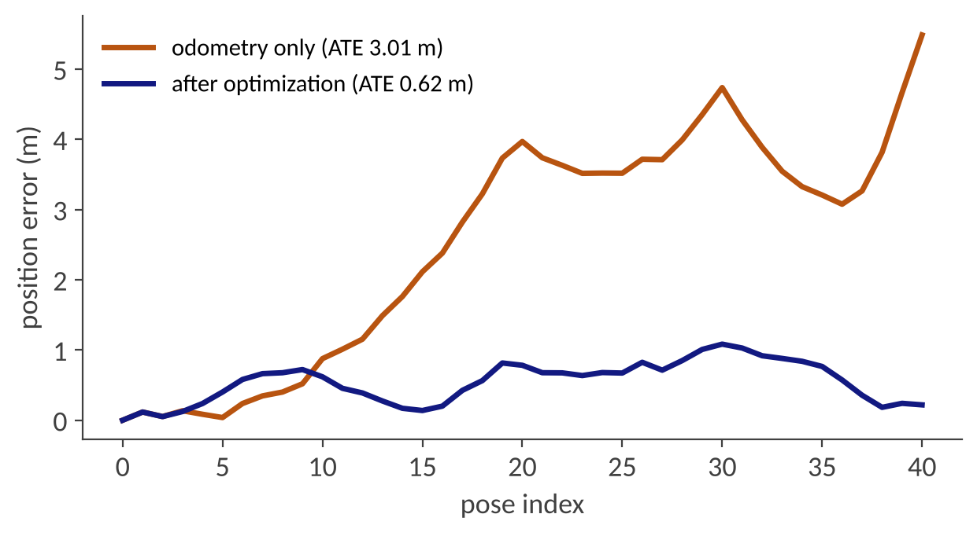
Part 4: Loop Closure and Evaluation
place recognition | false loops | robust back-ends | ATE and RPE

Slide 38
Loop Closure: Detect, Verify, Add
Detect: find candidate places seen before; images → bag of visual words, LiDAR → global descriptors (e.g., Scan Context)
Verify: geometric check (RANSAC + registration such as ICP) that the two views really align
Add: insert an edge with the measured relative pose and its covariance; re-optimize
Two failure types: false negatives (drift stays) and false positives (map is distorted)
Perceptual aliasing: repeated structures (identical shelves, tunnels, highway segments) cause false positives
Kaess et al. iSAM2 (incremental solving); Kim and Kim, Scan Context, IROS 2018; Cadena et al., T-RO 2016.

Slide 39
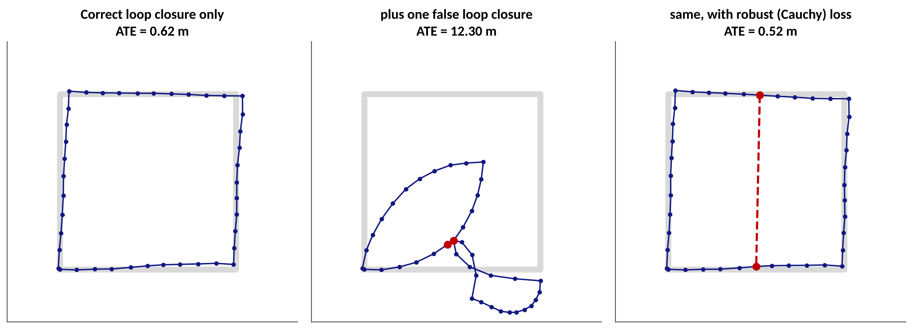
A False Loop Closure Ruins the Map
A single false edge (poses 25 and 5 declared to be the same place) raises the ATE from 0.62 m to 12.3 m
A robust loss (Cauchy) down-weights the inconsistent edge: ATE 0.52 m. Other defenses: switchable constraints, consistency checks
The robust run started from the previous estimate; robust losses do not remove the need for a good initial guess
Original simulation on the pose graph from slide 35; false edge has the same information matrix as the true loop closure.

Slide 40
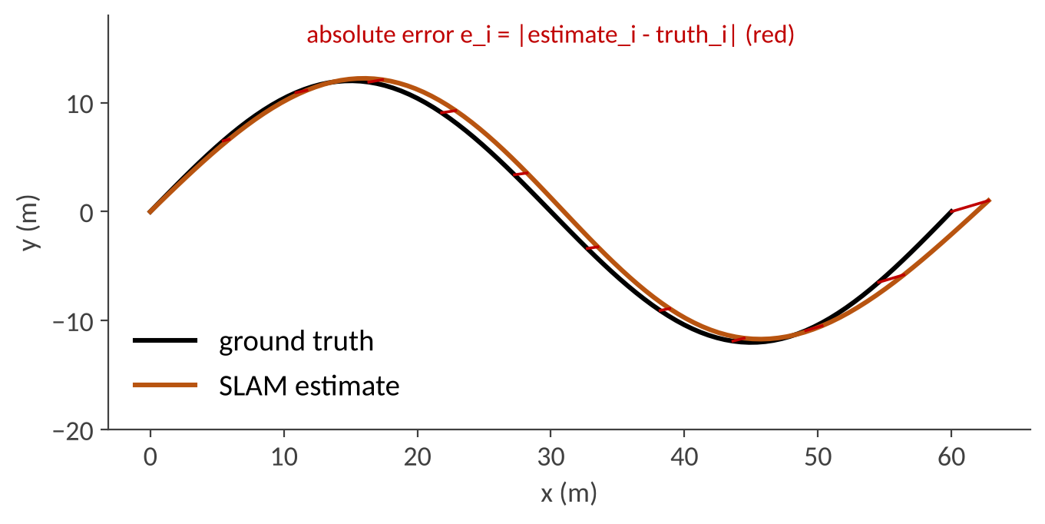
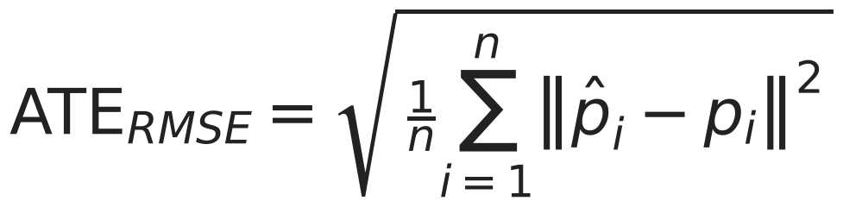
Evaluating SLAM: ATE and RPE
ATE (absolute trajectory error): global consistency; the estimate is first aligned to the ground truth (rigid or similarity transform).
RPE (relative pose error): drift over a fixed interval; compares relative motions.
KITTI odometry reports translation error (%) and rotation error (deg/m) averaged over segments of 100 m to 800 m
EuRoC and TUM report ATE RMSE in meters; always state whether scale was aligned (monocular systems)
Evaluate with an established tool (e.g., the evo package) and report several runs: SLAM is stochastic
Sturm et al., "A Benchmark for the Evaluation of RGB-D SLAM Systems", IROS 2012; Geiger et al., KITTI, CVPR 2012. Figure: original.

Slide 41
Which Method When?
 | EKF-SLAM | FastSLAM | Graph SLAM
State kept | pose + N landmarks (Gaussian) | M paths + N·M small EKFs | all poses (and landmarks)
Cost per update | O(N²) | O(M log N) | sparse solve; incremental (iSAM2)
Revise the past? | no (marginalized) | only via resampling | yes (re-linearize)
Data association | one hypothesis | one per particle | can be verified and revoked
Sensor fusion | natural (filter) | awkward | natural (any factor)
Typical use today | fusion filters, teaching | 2D grid mapping | visual and LiDAR SLAM, HD-map building
Summary; see Cadena et al. (2016) for the full taxonomy.

Slide 42
In-Class Activity and Lab Ideas
Hand calculation (10 min): 1-D pose graph and 1-D EKF-SLAM from slides 21 and 34 with new numbers (see the exercise deck)
Python (30 min): implement a 2-D pose graph with scipy.optimize.least_squares: odometry edges, one loop-closure edge, then add a false edge and a robust loss
Library demo: run a GTSAM or g2o example dataset and plot the trajectory before and after optimization
Discussion: if a loop closure is wrong by 5 m, which module (front-end or back-end) should detect it, and how?

Slide 43
Summary and Further Resources
Key takeaways
Further resources
SLAM estimates the map and the pose together; dead reckoning alone drifts without bound
EKF-SLAM: one Gaussian, O(N²), landmarks become correlated; wrong data association is fatal
FastSLAM: particles for the path, tiny EKFs for landmarks, O(M log N)
Graph SLAM: poses and constraints, sparse Gauss-Newton; loop closures correct drift
Evaluate with ATE / RPE; false loop closures are the main risk
Thrun, Burgard, Fox: Probabilistic Robotics (Ch. 10, 11, 13)
Grisetti et al.: A Tutorial on Graph-Based SLAM (2010)
Cadena et al.: Past, Present, and Future of SLAM (T-RO 2016)
UW CSE 571 lecture slides (EKF-SLAM) and Univ. Bonn (C. Stachniss) graph-SLAM slides, both online
GTSAM, g2o, and Ceres: open-source back-ends
Links are listed on the next slide. Next: L9.2 Modern SLAM for AD.

Slide 44
References
[1] S. Thrun, W. Burgard, D. Fox, Probabilistic Robotics, MIT Press, 2005 (Ch. 10 EKF-SLAM, Ch. 11 GraphSLAM, Ch. 13 FastSLAM).
[2] H. Durrant-Whyte, T. Bailey, "Simultaneous Localization and Mapping: Part I / Part II", IEEE Robotics & Automation Magazine, 2006.
[3] R. Smith, M. Self, P. Cheeseman, "Estimating Uncertain Spatial Relationships in Robotics", 1990.
[4] G. Grisetti, R. Kümmerle, C. Stachniss, W. Burgard, "A Tutorial on Graph-Based SLAM", IEEE ITS Magazine, 2010.
[5] M. Montemerlo, S. Thrun, D. Koller, B. Wegbreit, "FastSLAM: A Factored Solution to the SLAM Problem", AAAI 2002.
[6] G. Grisetti, C. Stachniss, W. Burgard, "Improved Techniques for Grid Mapping with Rao-Blackwellized Particle Filters", IEEE T-RO, 2007.
[7] C. Cadena et al., "Past, Present, and Future of SLAM", IEEE T-RO, 2016.
[8] R. Kümmerle et al., "g2o: A General Framework for Graph Optimization", ICRA 2011; F. Dellaert, M. Kaess, "Factor Graphs for Robot Perception", 2017.
[9] J. Sturm et al., "A Benchmark for the Evaluation of RGB-D SLAM Systems", IROS 2012; A. Geiger et al., KITTI, CVPR 2012.
[10] UW CSE 571 (2023), Lecture 8 EKF-SLAM: courses.cs.washington.edu/courses/cse571/23sp/slides/L08/Lecture08_EKFSLAM.pdf
[11] C. Stachniss, Univ. Bonn, Graph-Based SLAM slides: ipb.uni-bonn.de/html/teaching/msr2-2020/sse2-05-graph-slam.pdf
[12] Figures: original simulations created for this lecture (NumPy / SciPy, Matplotlib).

